Slide 1
UML – Class Diagram

Slide 2
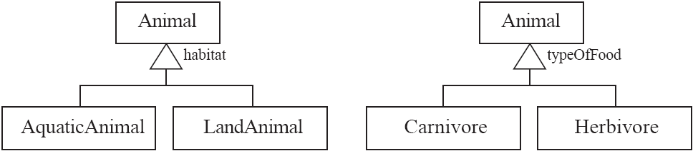
Generalization
Specializing a superclass into two or more subclasses
A generalization set is a labeled group of generalizations with a common superclass
The label (sometimes called the discriminator) describes the criteria used in the specialization

Slide 3
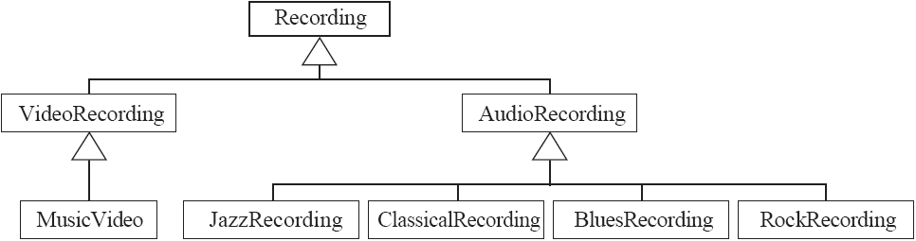
Avoiding unnecessary generalizations
Inappropriate hierarchy of classes, which should be instances

Slide 4
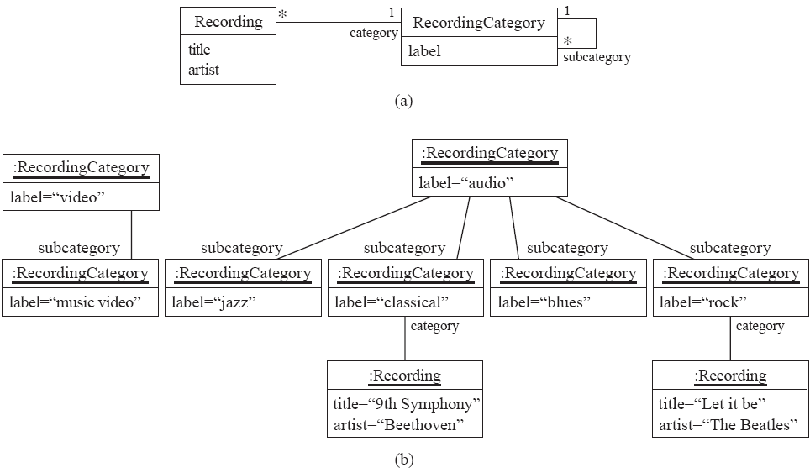
Avoiding unnecessary generalizations (cont)
Open in Umple
Improved class diagram, with its corresponding instance diagram

Slide 5
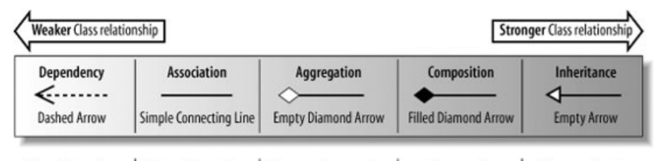
Relationships

Slide 6
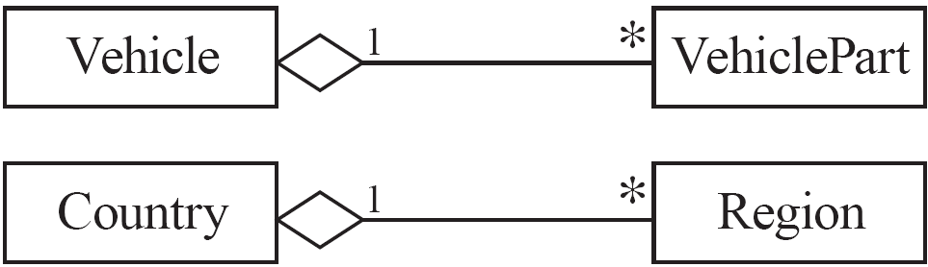
More Advanced Features: Aggregation
Aggregations are special associations that represent ‘part-whole’ relationships.
The ‘whole’ side is often called the assembly or the aggregate
This symbol is a shorthand notation association named isPartOf
Notes:
aggregations are specified using a diamond symbol,
which is placed next to the aggregate. This symbol is a shorthand notation that
saves you from having to write an association name such as isPartOf or its
inverse hasParts. Many aggregations are one-to-many, but this is not a
requirement.

Slide 7
When to use an aggregation
As a general rule, you can mark an association as an aggregation if the following are true:
You can state that
the parts ‘are part of’ the aggregate
or the aggregate ‘is composed of’ the parts
When something owns or controls the aggregate, then they also own or control the parts
Notes:
On the other hand, the members of a club are not in an
aggregation relationship with the club. It might sometimes be possible in
English to say that a person is part of a club, but the owner of the club does not
own the members.

Slide 8
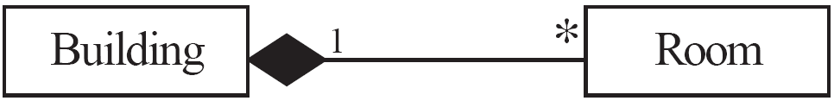
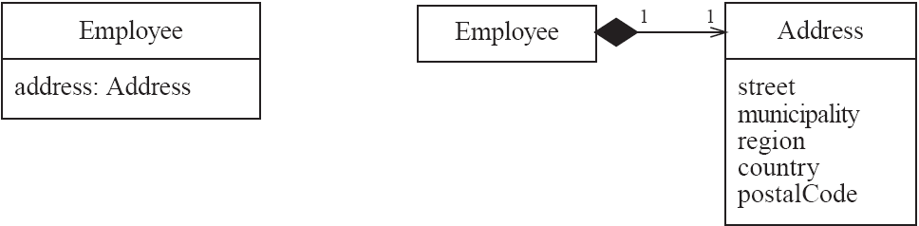
Composition
A composition is a strong kind of aggregation
if the aggregate is destroyed, then the parts are destroyed as well
Two alternatives for addresses
Notes:
A composition is a strong kind of aggregation in which if the aggregate is
destroyed, then the parts are destroyed as well. A composition is shown using a
solid (filled-in) diamond, as opposed to an open one. The parts of a composition
can never have a life of their own; they exist only to serve the aggregate. For
example, as shown in the bottom example of Figure 5.19, the rooms of a building
cannot exist without the building. In ordinary aggregations, on the other hand,
the parts can exist on their own. For example, the engine can be taken out of one
vehicle and placed in another, or a region can secede from one country and
become indeendent.
Marking a part–whole association as an aggregation using the diamond
symbol is optional. Leaving it as an ordinary association is not an error, whereas
marking a non-aggregation with a diamond is an error and can cause confusion.
Therefore, as a general rule of thumb: when in doubt, leave it out.

Slide 9
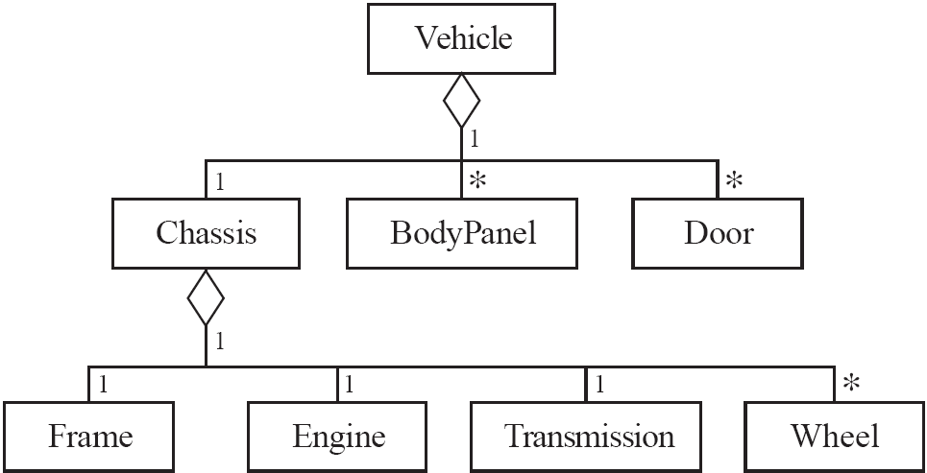
Aggregation hierarchy
Notes:
An operation to register the sale of a vehicle would only need to record the new
owner of the aggregate. There would be no need to also record the new owner
of all the parts, since if any subsequent query were made about the ownership
of a part, the part could simply return the owner of the aggregate.
■ An operation to delete an aggregate could automatically delete the parts.
■ An operation to change the thickness of the outline of a shape might work by
simply changing the thickness of all of the line segments that compose the
shape

Slide 10
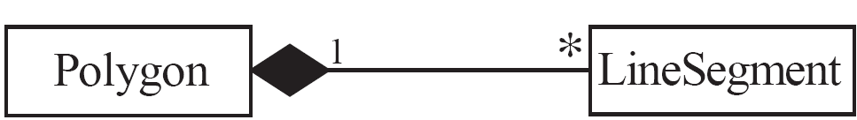
Propagation
A mechanism where an operation in an aggregate is implemented by having the aggregate perform that operation on its parts
At the same time, properties of the parts are often propagated back to the aggregate
Propagation is to aggregation as inheritance is to generalization.
The major difference is:
inheritance is an implicit mechanism
propagation has to be programmed when required
Notes:
a mechanism called propagation that is often
present in aggregations. Under this mechanism, an operation in an aggregate is
implemented by having the aggregate perform that operation on its parts – in
other words, the operation is propagated to the parts. At the same time, this
process often results in the features of the parts being propagated back to the
aggregate. For example, the weight of an aggregate could be obtained by
summing the weights of its parts.
In a sense, we can say that propagation is to aggregation as inheritance is to
generalization. However, the major difference is that inheritance is an implicit
mechanism, whereas propagation has to be programmed when required.
The justification is as follows:
■ A polygon is composed of line segments.
■ An object that manipulates a polygon also manipulates the line segments.
■ When the polygon is translated or scaled, the line segments are also translated
or scaled.
■ The perimeter of the polygon is computed as the sum of the lengths of all the
line segments.
■ Removing a line segment from a polygon would mean that the polygon is no
longer a polygon, therefore the polygon must have complete control to prevent
such a change.
■ The line segments are deleted when the polygon is deleted.

Slide 11
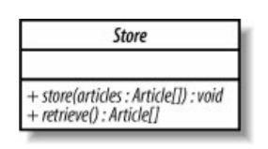
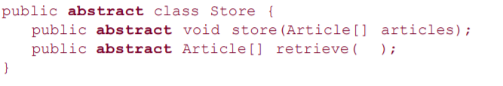
Abstract class
When the concrete implementation of methods
are left for the subclasses.
Can contain both abstract and non-abstract methods

Slide 12
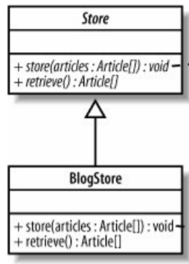
Abstract class

Slide 13
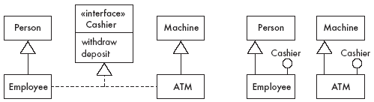
Interfaces
An interface is similar to a class, except it lacks instance variables and implemented methods
An interface describes a portion of the visible behaviour of a set of objects.
Notes:
It is very similar to abstract class concept, but contains only abstract methods
An interface in Java is very much like an abstract class, except that it can have
neither instance variables nor concrete methods – it is basically a named list of
abstract operations. We instead create several implementing classes (rather than
subclasses) of an interface that must implement the abstract operations. A class
can implement multiple interfaces, but can have only one superclass
A key feature that gives interfaces their power is that you can declare a
variable with an interface as its type. This means that an instance of any class
that implements the interface can be put in the variable. With the variable, you
can then call any of the operations defined in the interface – dynamic binding
operates in the same way as with generalization
Multiple inheritance
In some programming languages, interfaces are simply created using
superclasses containing only abstract methods. But interfaces should not be
confused with generalizations since the basic relation is not the same. We have
already mentioned that generalization is characterized by an isa relationship
between a subclass and a superclass. In the case of interfaces, the relationship
between the implementing class and the interface can be described as ‘can-beseen-
as’.
A key advantage of using interfaces is that they reduce what is called the
coupling between classes.

Slide 14
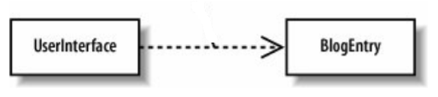
Dependency
A class needs to know about the other class in order use it’s objects
When the UserInterface wants to display, it accesses BlogEntry
Dependency implies only that the classes can work together, so is the weakest relationship

Slide 15
Notes and descriptive text
Descriptive text and other diagrams
Embed your diagrams in a larger document
Text can explain aspects of the system using any notation you like
Highlight and expand on important features, and give rationale
Notes:
A note is a small block of text embedded in a UML diagram
It acts like a comment in a programming language
Constraints:
A constraint is like a note, except that it is written in a formal language that can be interpreted by a computer
Recommended language is Object Constraint Language

Slide 16
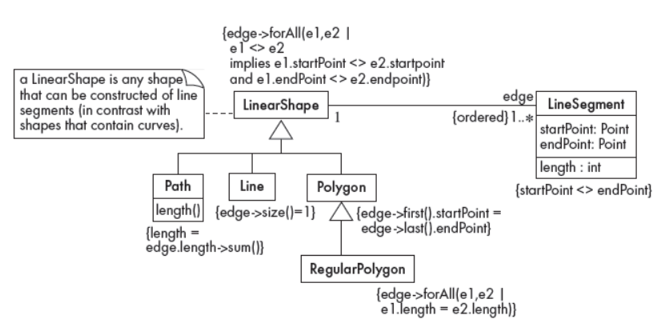

Slide 17
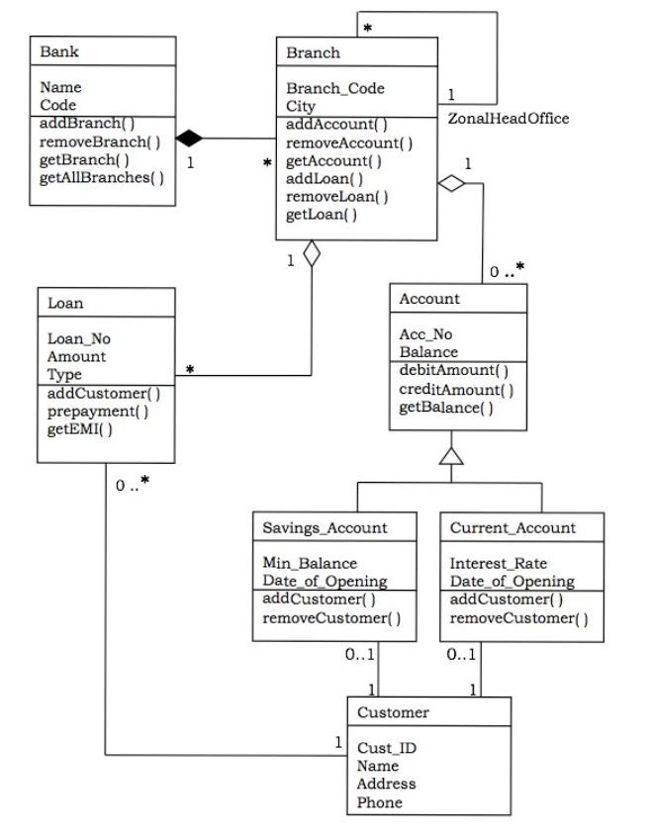
An Example

Slide 18
Suggested sequence of activities
Identify a first set of candidate classes
Add associations and attributes
Find generalizations
List the main responsibilities of each class
Decide on specific operations
Iterate over the entire process until the model is satisfactory
Add or delete classes, associations, attributes, generalizations, responsibilities or operations
Identify interfaces
Don’t be too disorganized. Don’t be too rigid either.

Slide 19
A simple technique for discovering domain classes
Look at a source material such as a description of requirements
Extract the nouns and noun phrases
Eliminate nouns that:
are redundant
represent instances
are vague or highly general
not needed in the application
Pay attention to classes in a domain model that represent types of users or other actors

Slide 20
Identifying associations and attributes
Start with classes you think are most central and important
Decide on the clear and obvious data it must contain and its relationships to other classes.
Work outwards towards the classes that are less important.
Avoid adding many associations and attributes to a class
A system is simpler if it manipulates less information

Slide 21
Tips about identifying and specifying valid associations
An association should exist if a class
possesses
controls
is connected to
is related to
is a part of
has as parts
is a member of, or
has as members
some other class in your model
Specify the multiplicity at both ends
Label it clearly.

Slide 22
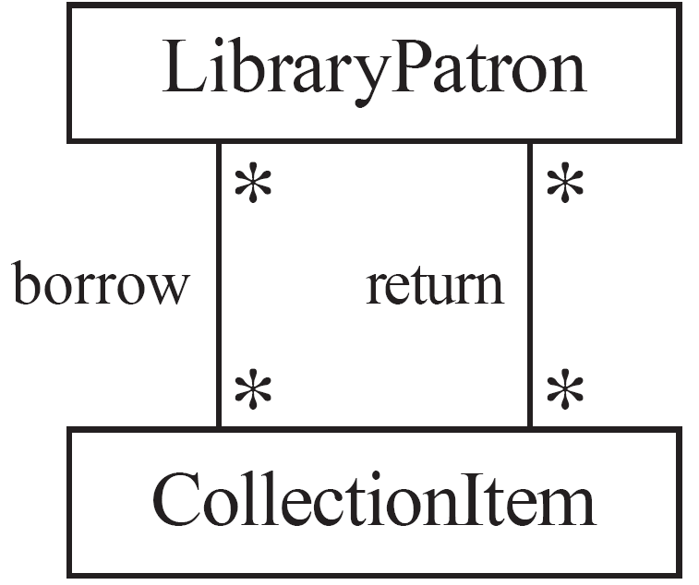
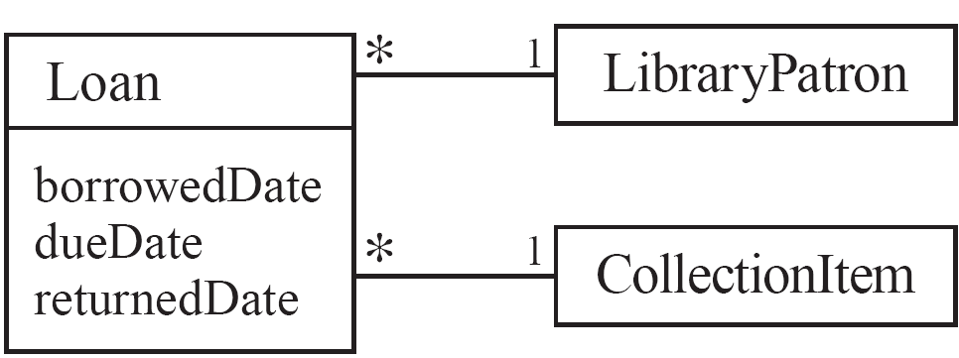
Actions versus associations
A common mistake is to represent actions as if they were associations

Slide 23
Identifying attributes
Look for information that must be maintained about each class
Several nouns rejected as classes, may now become attributes
An attribute should generally contain a simple value
E.g. string, number

Slide 24
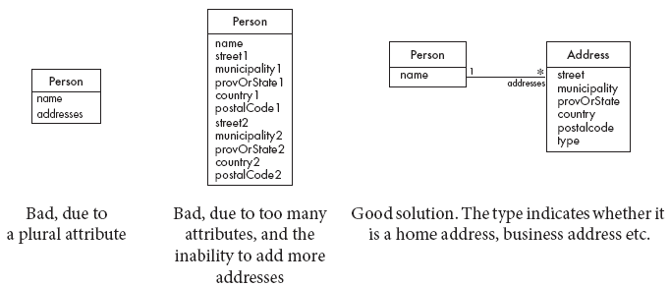
Tips about identifying and specifying valid attributes
It is not good to have many duplicate attributes
If a subset of a class’s attributes form a coherent group, then create a distinct class containing these attributes

Slide 25
Identifying generalizations and interfaces
There are two ways to identify generalizations:
bottom-up
Group together similar classes creating a new superclass
top-down
Look for more general classes first, specialize them if needed
Create an interface, instead of a superclass if
The classes are very dissimilar except for having a few operations in common
One or more of the classes already have their own superclasses
Different implementations of the same class might be available

Slide 26
Allocating responsibilities to classes
A responsibility is something that the system is required to do.
Each functional requirement must be attributed to one of the classes
All the responsibilities of a given class should be clearly related.
If a class has too many responsibilities, consider splitting it into distinct classes
If a class has no responsibilities attached to it, then it is probably useless
When a responsibility cannot be attributed to any of the existing classes, then a new class should be created
To determine responsibilities
Perform use case analysis
Look for verbs and nouns describing actions in the system description

Slide 27
Categories of responsibilities
Setting and getting the values of attributes
Creating and initializing new instances
Loading to and saving from persistent storage
Destroying instances
Adding and deleting links of associations
Copying, converting, transforming, transmitting or outputting
Computing numerical results
Navigating and searching
Other specialized work

Slide 28
Identifying operations
Operations are needed to realize the responsibilities of each class
There may be several operations per responsibility
The main operations that implement a responsibility are normally declared public
Other methods that collaborate to perform the responsibility must be as private as possible

Slide 29
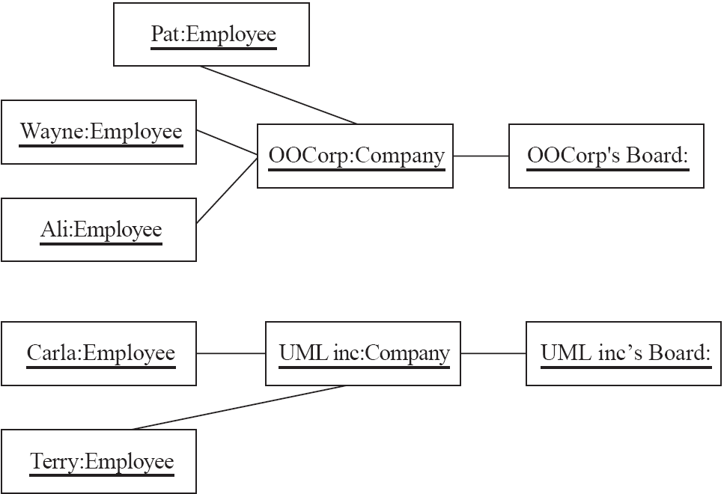
Object Diagrams
A link is an instance of an association
In the same way that we say an object is an instance of a class

Slide 30
Associations versus generalizations in object diagrams
Associations describe the relationships that will exist between instances at run time.
When you show an instance diagram generated from a class diagram, there will be an instance of both classes joined by an association
Generalizations describe relationships between classes in class diagrams.
They do not appear in instance diagrams at all.
An instance of any class should also be considered to be an instance of each of that class’s superclasses

